Slide 1
Computer and Network Forensics
CSE 469 - Computer and Network Forensics
Spring 2017
F 7:30AM – 10:15AM
Tempe LSE 150
Ziming Zhao, CSE 469 Computer and Network Forensics

Slide 2


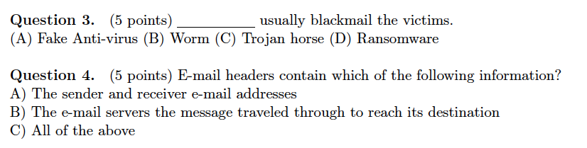
Midterm #2
A
D
D
C

Slide 3
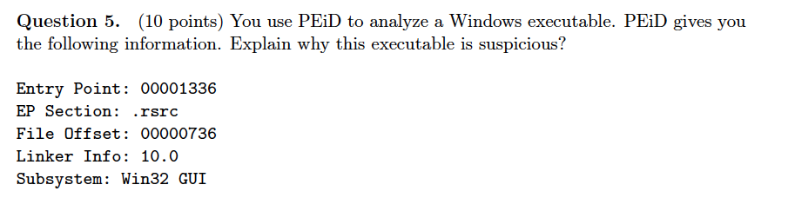
Midterm #2

Slide 4
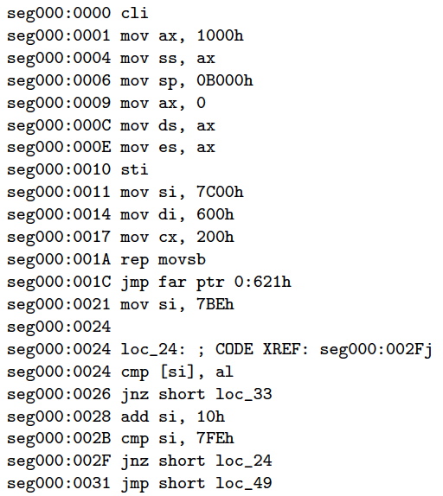
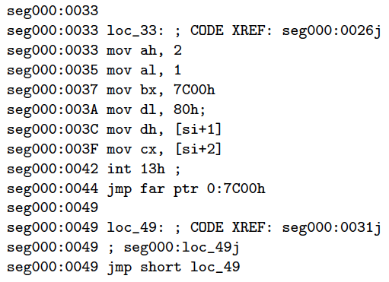
Midterm #2

Slide 5
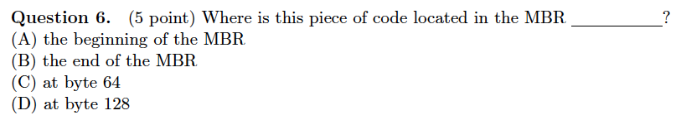
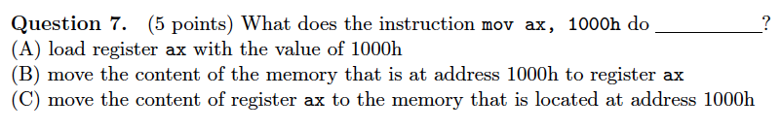
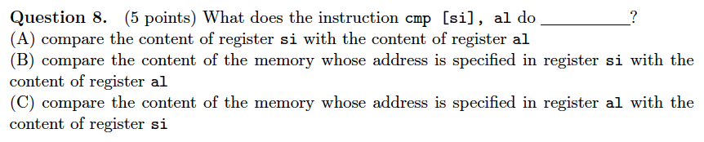
Midterm #2

Slide 6
Midterm #2

Slide 7
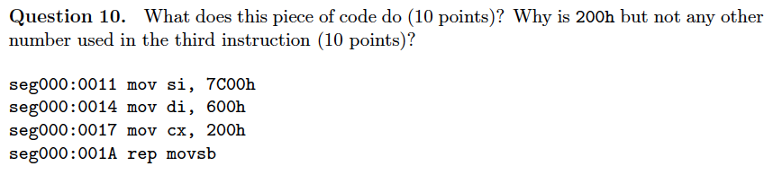

Slide 9
Memory Forensics

Slide 10
Disk Forensics
Hard Disk
Storage Media Analysis
Volume Analysis
File System Analysis
Sectors of data
Volume
File

Slide 11
Understanding Full Disk Encryption
In recent years, there has been more concern about loss of
Personal identity information (PII) and trade secrets caused by computer theft
Of particular concern is the theft of laptop computers and other handheld devices
To help prevent loss of information, software vendors now provide whole disk encryption

Slide 12
Understanding Full Disk Encryption
Current whole disk encryption tools offer the following features:
Preboot authentication
Full or partial disk encryption with secure hibernation
Advanced encryption algorithms
Key management function
A Trusted Platform Module (TPM) microchip to generate encryption keys and authenticate logins

Slide 13
Understanding Full Disk Encryption
Whole disk encryption tools encrypt each sector of a drive separately
Many of these tools encrypt the drive’s boot sector
To prevent any efforts to bypass the secured drive’s partition
To examine an encrypted drive, decrypt it first
Run a vendor-specific program to decrypt the drive

Slide 14
Microsoft BitLocker
Hardware and software requirements
A computer capable of running Windows Vista
The TPM microchip, version 1.2 or newer
A computer BIOS compliant with Trusted Computing Group (TCG)
Two NTFS partitions
The BIOS configured so that the hard drive boots first before checking other bootable peripherals

Slide 15
Other Disk Encryption Tools
Some available third-party WDE utilities:
PGP Whole Disk Encryption
Voltage SecureDisk
Utimaco SafeGuard Easy
Jetico BestCrypt Volume Encryption
SoftWinter Sentry 2020 for Windows XP
Some available open-source encryption tools:
TrueCrypt
CrossCrypt
FreeOTFE

Slide 16
What is BitLocker
Full Disk encryption (FDE)
Can be used with/without aTrusted Platform Chip (TPC)
Included on Windows Vista, both Ultimate and Enterprise versions and on Windows Server 2008
Has AES encryption with a 128 key in Cipher Block Chaining (CBC) mode
Uses an Elephant Diffuser for additional security

Slide 17
3 Modes of BitLocker
Transparent operation mode: Requires a Trusted Platform Module (TPM) 1.2 hardware chip with built-in encryption key. The key used for the disk encryption is sealed (encrypted) by the TPM chip and will only be released to the OS loader code if the early boot files appear to be unmodified.
User authentication mode: User provides pre-boot PIN to boot the OS.
USB Key: (No TPM needed) Must use jump drive that contains a startup key to be able to boot the OS. (provided that the BIOS can read a jump drive before running the OS)
TPM
TPM + PIN
TPM + PIN + USB Key
TPM + USB Key
USB Key

Slide 18
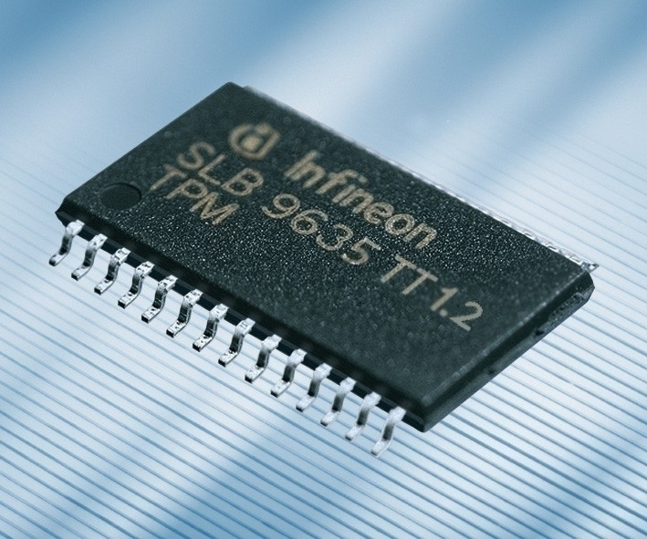
Trusted Platform Module (TPM)
The TPC is a hardware chip on the Motherboard.
Has several Platform Configuration Registers (PCR) whose current value at any given time can only be attained through the same sequence of operations after power-up.

Slide 19
How BitLocker Works
BitLocker Encryption is done a sector at a time
Each sector is usually 512 bytes, but could be as much as 8192 bytes
Each sector is encrypted independently of the other sectors

Slide 20
Memory Forensics
Memory forensics is forensic analysis of a computer's memory dump.
… investigation of advanced computer attacks which are stealthy enough to avoid leaving data on the computer's hard drive. Malware detection.

Slide 21
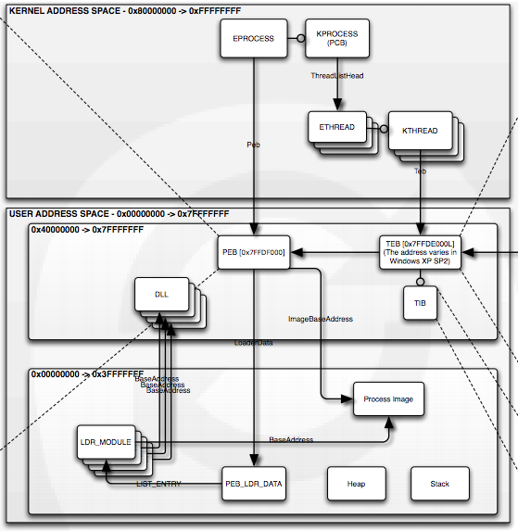
Windows Memory Layout

Slide 22
Memory Acquisition
Acquisition (software based)
Moonsols Windows Memory Toolkit (Win32dd, Win64dd)
Mandiant Memoryze
FTK Imager
User mode and kernel mode (driver) component, because physical memory cannot be read from the user mode

Slide 23
In-Class Exercise 9

Slide 24
Building the Memory Image
Do some typical work on a Windows 7 laptop:
Open web-based email and send a message.
Open Internet Explorer and log into Yahoo email.
Open CMD window and get a directory listing.
Do search for “win7-memory-forensics.”
Look at Task Manager and NETSTAT.
Check Computer → Properties.

Slide 25
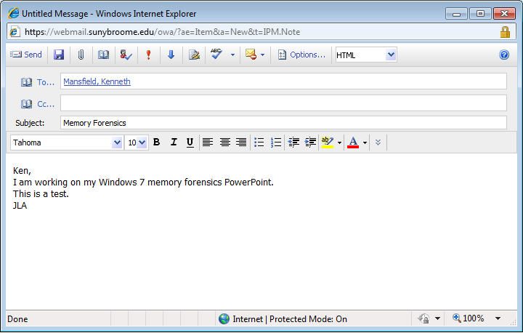
Building the Memory Image

Slide 26
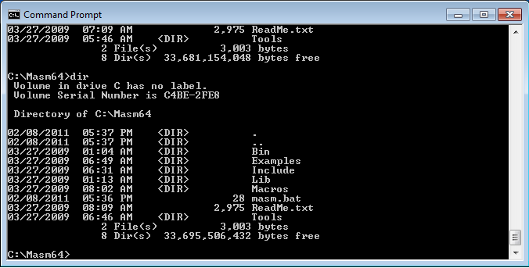
Building the Memory Image

Slide 27
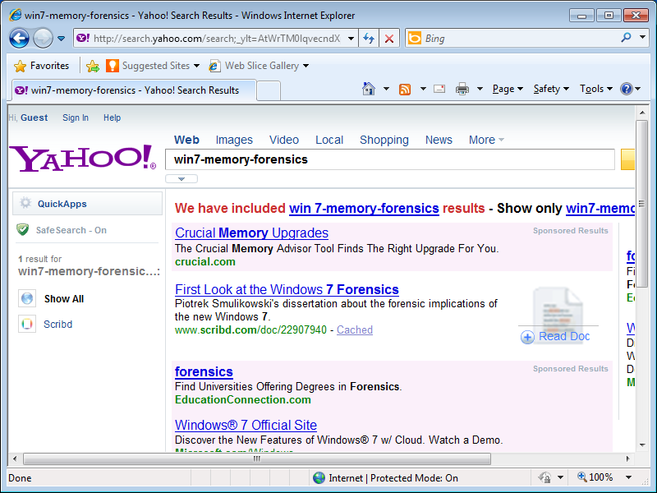
Building the Memory Image

Slide 28
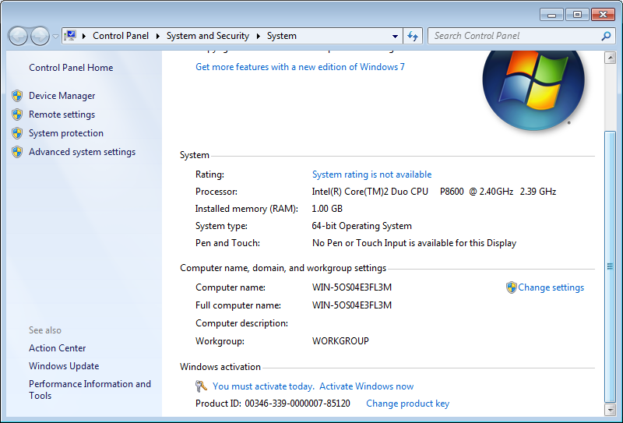
Building the Memory Image

Slide 29
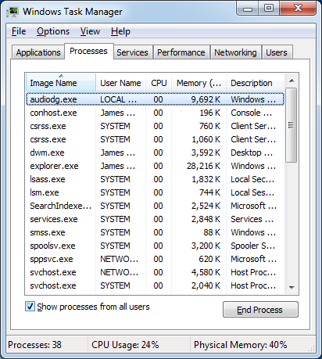
Building the Memory Image

Slide 30
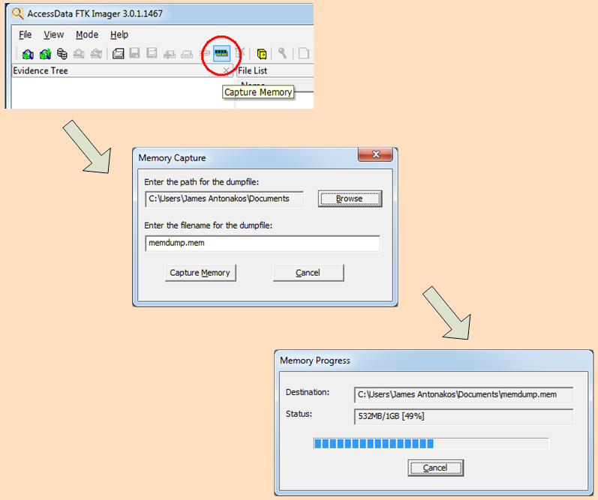
Acquiring the Memory Image

Slide 31
Using STRINGS
Use the STRINGS program to extract ASCII strings from memory dump file.
Download strings from http://live.sysinternals.com/strings.exe

Slide 32
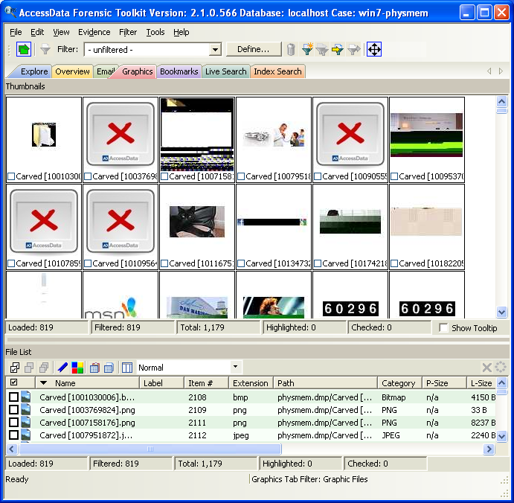
Analyzing Memory using FTK

